Slide 1
Interrobang
John Hardy
Joey Martinez
Merci Magallanes

Slide 2

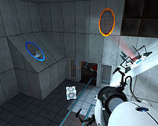
Description
Interrobang is a looping 3D puzzle platformer
Same levels used over and over with small changes in each iterations
Similar to : Antichamber, this is the only level, Museum of Simulation Technology, and Mirror’s edge
Target audience: anyone over 8 years of age with interest in puzzle games

Slide 3
Justification
We will be utilizing concepts learned in Interaction Design, Programming Languages, and Game Design
Some in the group will learn how to write code in C# for the first time. We will also implement our own user interface from scratch thus expanding on concepts we have learned.
If we feel that our project is moving along too easily, we could scale up the game by adding more content. We feel that the ideas we have already should be enough to keep us quite busy.
The scalability of the project allows it to fit within the time constraints of the semester.
We will have access to Unity and 3D modeling software for free through LMU.
Both teammates have expressed interest in game design, and want to use this experience to further their understanding of game design.
fart

Slide 4


Specifications
Designed to be run on most personal computers (not graphically intensive).
Runs on the Unity game engine.
Will use assets freely available on public domain or assets created by us.
Maya for 3D modeling of assets we may need.

Slide 5
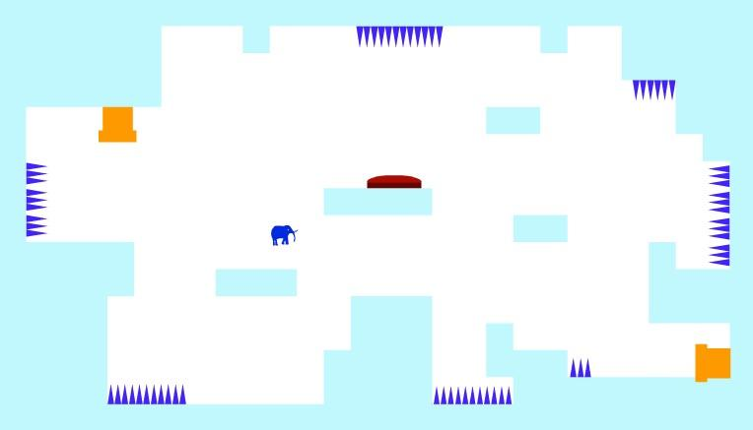
This is the Only Level

Slide 6
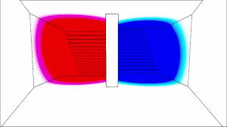
Antichamber

Slide 7
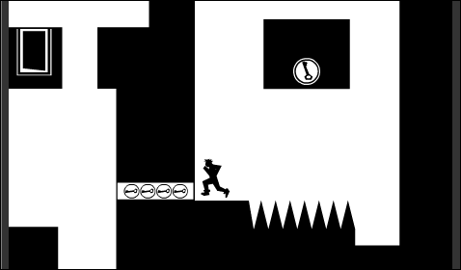
Shift

Slide 8
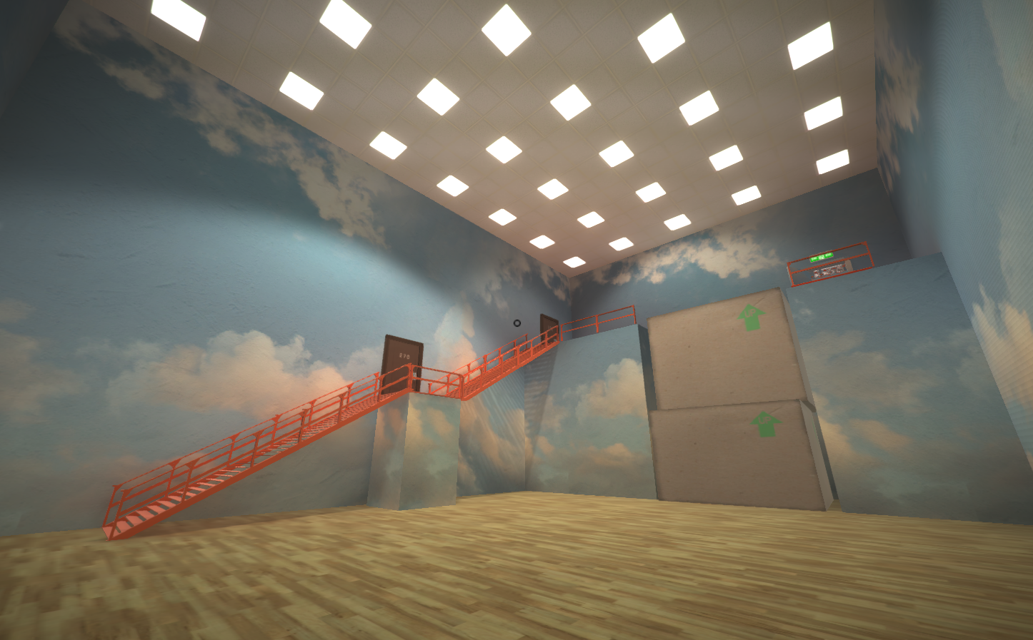
Museum of Simulation Technology

Slide 9
Questions?

